Slide 1

Growing William Grant & Sons Brands
DISTRIBUTION
VISIBILITY
RATE OF SALE
Venue partners: Viajante87, Trailer Happiness and Sopwell House

Slide 2
a
The Commercial Framework
Distribution
Placing the right brands in the right tier within the right venue. Strategic listings that respect venue identity whilst driving portfolio growth.
Visibility
Menu placement, signature serves, and compelling back-bar presence. Making brands impossible to ignore at the point of decision.
Rate of Sale
Building staff confidence through training, structured upselling, and strategic feature rotation that drives consistent velocity.

Slide 3
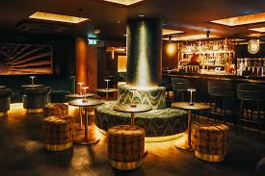
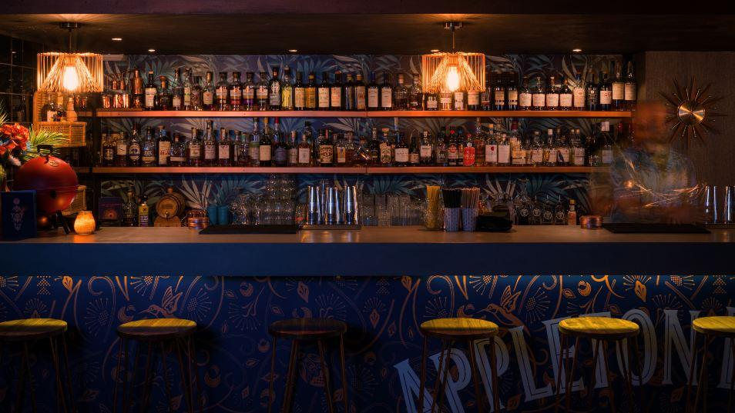
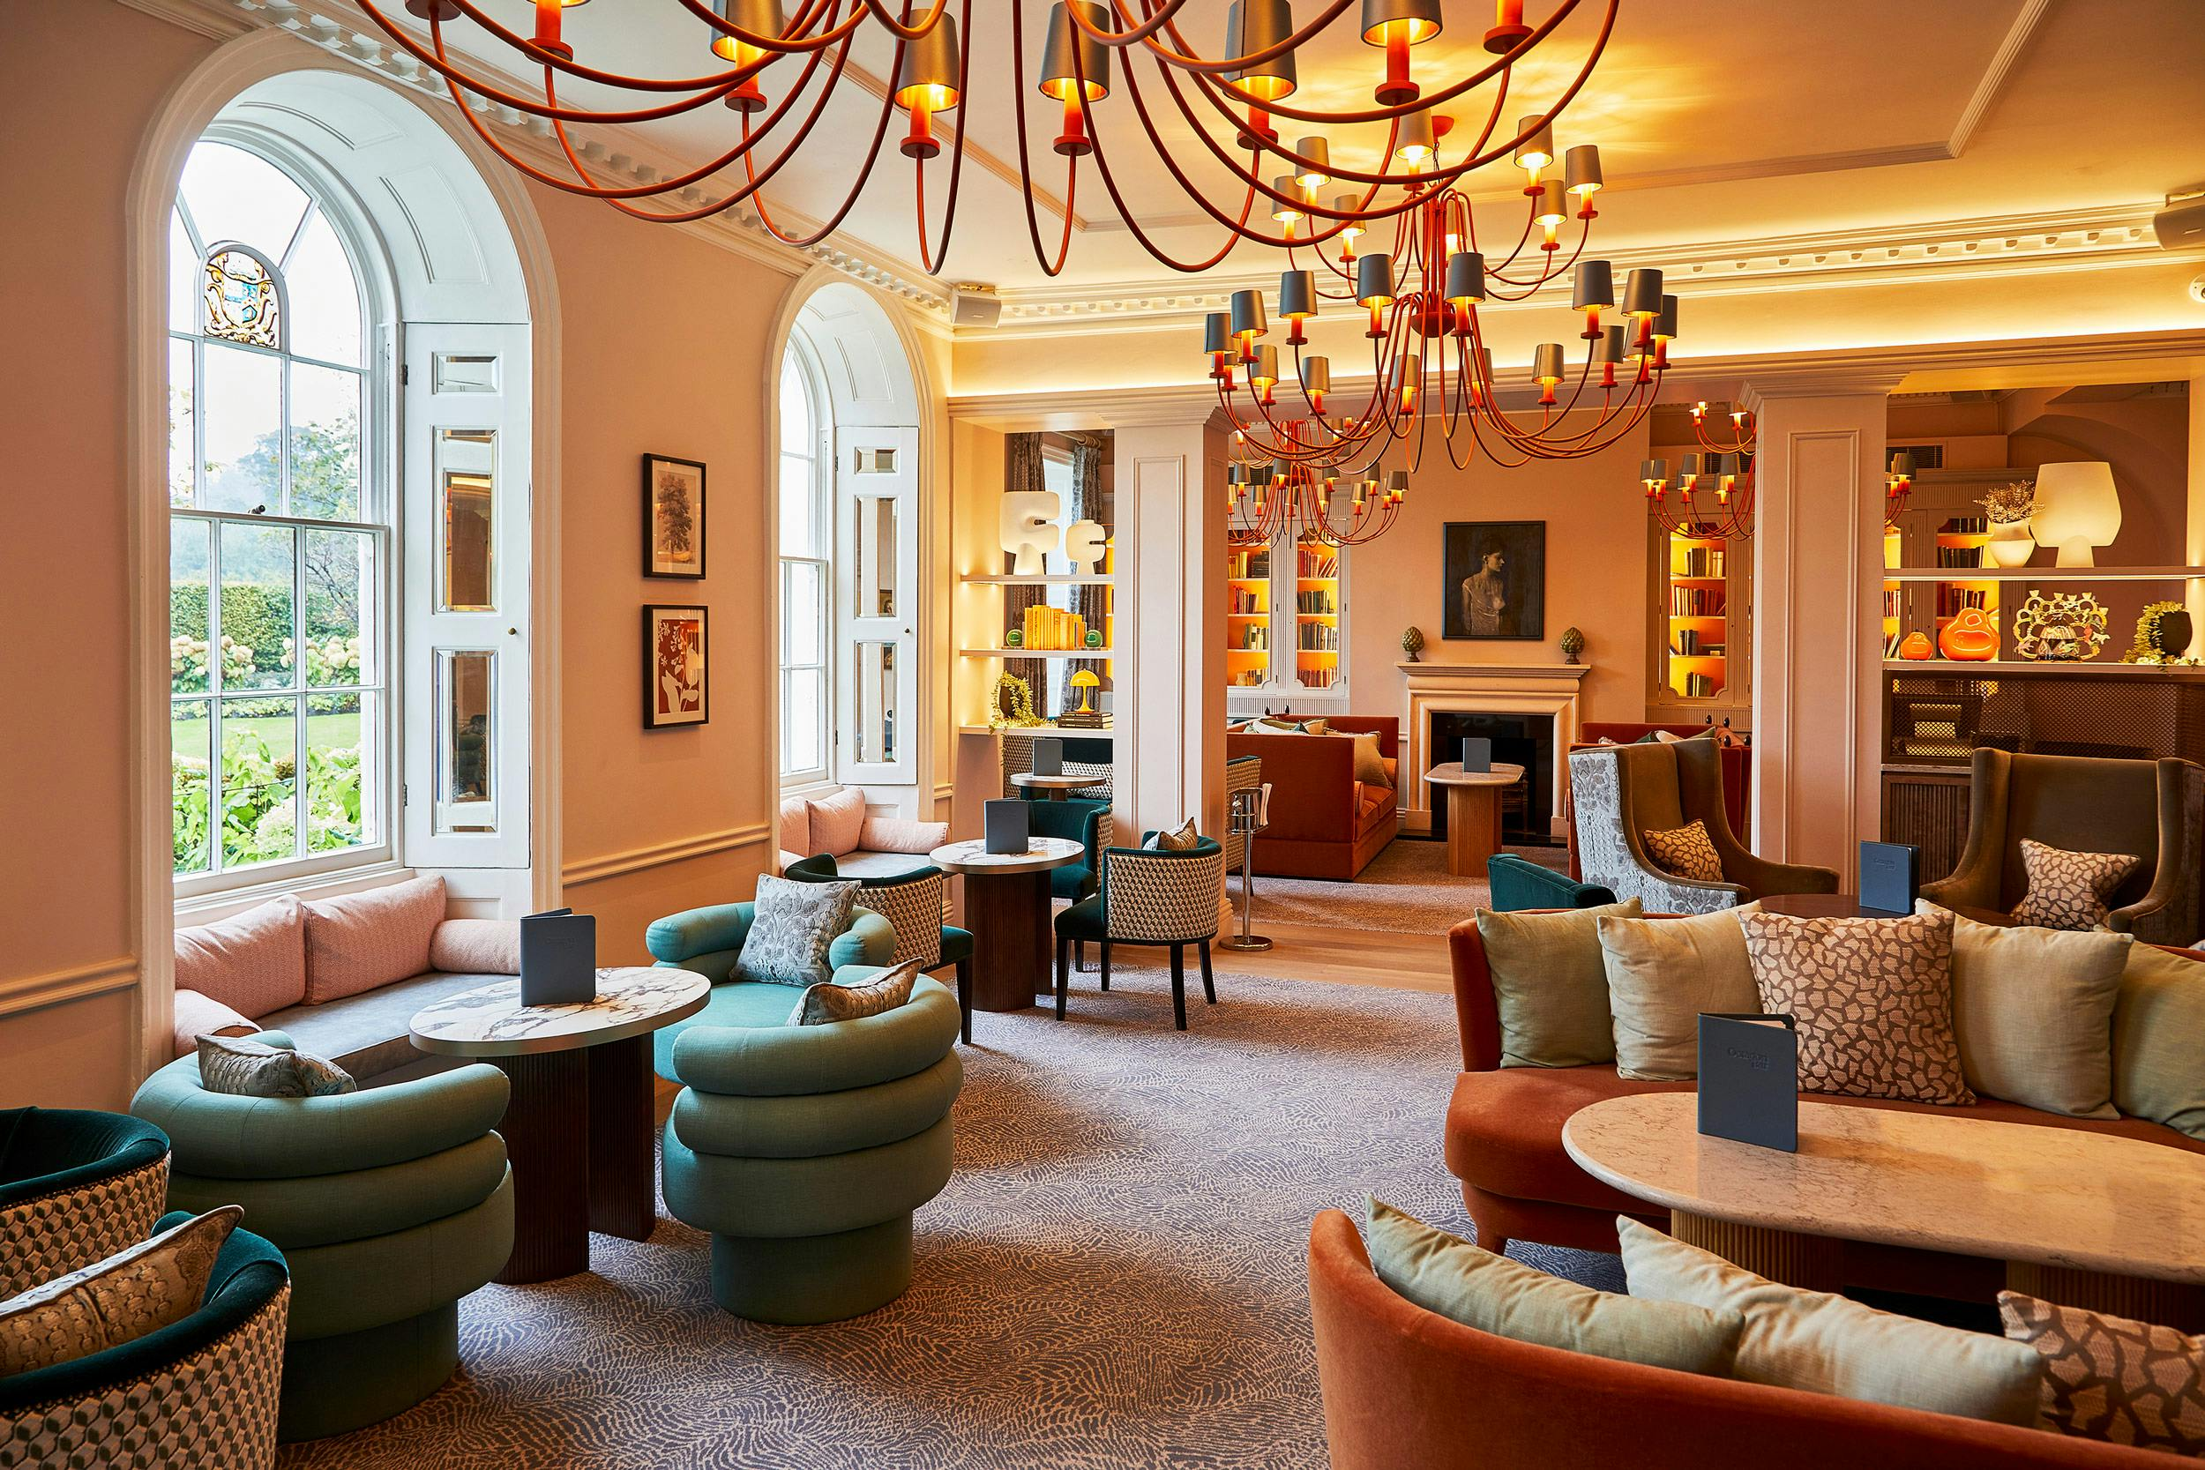
Understanding the Venues
Viajante87
Latin American-inspired cocktail bar. Agave-heavy listings with premium pricing (£16–£30). Discovery-driven clientele influenced heavily by skilled bartenders.
Trailer Happiness
Rum-dominant tiki venue operating at high volume. Speed rail efficiency is critical. Occasion-based drinking patterns with strong weekend performance.
Sopwell House
Luxury countryside hotel with spa and experiential guests. Significant banqueting opportunities within a premium margin environment.

Slide 4


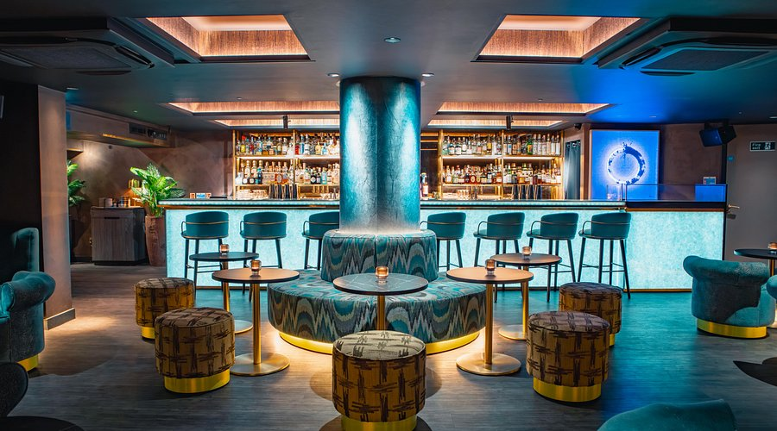

Viajante87: Crossover & Curiosity
Focus Brands
Distribution
Hendrick's Gin
Monkey Shoulder
Silent Pool Gin
Milagro Tequila
Permanent Hendrick's listing, Monkey Shoulder in stirred section, Silent Pool as premium English gin tier.
Visibility
Latin-inspired Hendrick's signature serve, Monkey Shoulder Manhattan-style reinterpretation, premium gin call-out on menu.
Rate of Sale
Staff tasting sessions, upsell scripting, and cocktail rotation to maintain freshness.

Slide 5

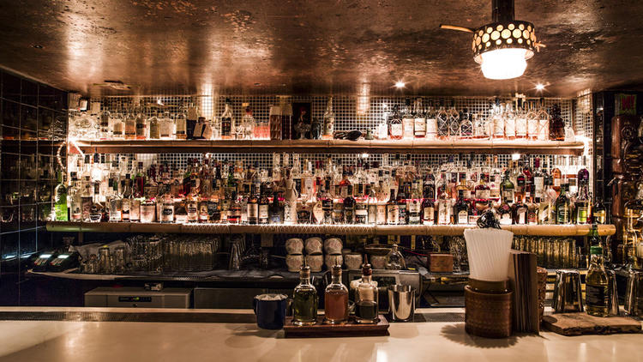



Trailer Happiness: Occasion Expansion
Distribution
Monkey Shoulder tiki-inspired cocktail, Hendrick's tropical highball, Reyka for classic execution, Sailor Jerry within rum rotation.
Visibility
One shareable Monkey Shoulder serve, seasonal Hendrick's feature, menu call-out for alternative spirit choice.
Rate of Sale
Weekend feature push, bartender upsell prompts, encourage to try something different moments at peak times.
Focus Brands: Monkey Shoulder (cocktail tier), Hendrick's Gin (premium alternative), Reyka Vodka (classics), Sailor Jerry (rum range extension).
If rum runs the party, Monkey Shoulder keeps it interesting.

Slide 6
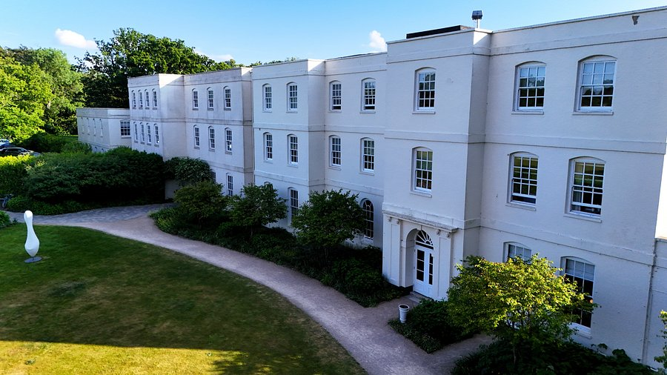
Sopwell House: Premium Ladder
Focus Brands
Glenfiddich
Balvenie
Grant's
The Famous Grouse
Hendrick's Gin
Monkey Shoulder
Covering entry, cocktail, and premium tiers within a luxury countryside setting.
Distribution
Visibility
Rate of Sale
Grant's and Famous Grouse for banqueting volume. Glenfiddich 12 & 15 permanently listed. Balvenie as premium upsell. Hendrick's as ritual G&T serve.
Whisky options, garden Hendrick’s events, premium whisky menu call-out, and suggested pairings.
Structured upsell training for front-of-house, suggested whisky pairings with dining, event package inclusion.

Slide 7
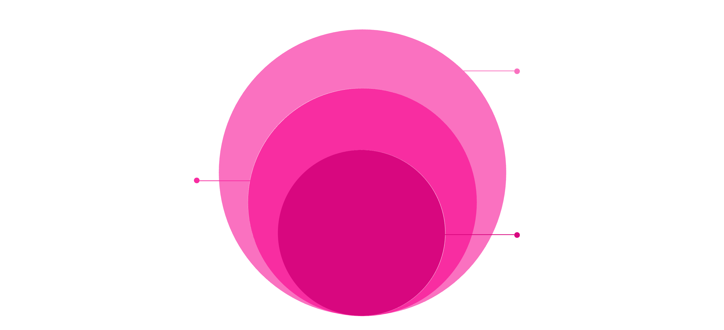
Portfolio Tiering Strategy
A structured approach to covering multiple price points whilst protecting venue identity and driving margin growth across all three outlets.
Base: Entry Tier
Grant's, Famous Grouse
Mid: Cocktail Tier
Monkey Shoulder, Hendrick's
Core: Premium Tier
Glenfiddich, Balvenie, Silent Pool
Objective: Drive volume at base. Drive margin at premium. Protect venue identity throughout every tier.
Volume Strategy
Margin Strategy
Entry tier drives accessible volume through Grant's and Famous Grouse in banqueting and well placements.
Premium tier delivers enhanced profitability through Glenfiddich, Balvenie, and Silent Pool in cocktail and neat serves.

Slide 8
90-Day Implementation Plan
Month 1: Audit & Secure
Month 3: Activation & Review
Run targeted activation per venue (tasting events, menu features). Review performance data and depletion. Expand successful placements and refine approach.
Meet venue managers and head bartenders. Understand their needs. Review current brand listings and identify opportunities. Secure one placement per outlet to build momentum.
1
2
3
Month 2: Visibility & Training
Deliver staff tasting sessions across all three venues. Launch signature serves with point-of-sale support. Secure permanent menu listings and back-bar presence.

Slide 9
KPIs & Measurement Framework
1-2
15-20%
100%
Menu Placements
Rate of Sale Uplift
Team Training
Permanent listings per outlet
Core SKU velocity increase
Bar staff engagement
What We'll Measure
Customer feedback
Menu presence and positioning
Staff confidence and advocacy levels
Additional portfolio adoption per site

Slide 10

Expected Commercial Impact
Short-Term Gains
Increased Hendrick's and Monkey Shoulder visibility across all three venues. Immediate volume growth via Grant's and Famous Grouse in banqueting and well placements.
Medium-Term Growth
Premium trade-up into Glenfiddich and Balvenie as staff confidence builds. Stronger multi-tier presence delivering balanced portfolio representation and improved margin mix.
Long-Term Partnership
Sustainable rate of sale driven by trained staff and embedded brand advocacy. Balanced portfolio dominance with profitable share growth across all price points. Portfolio becomes default supplier choice

Slide 11
Growing William Grant & Sons Brands
Some more ideas, because I am a Rare Character
Collaborate with influencers
Volume Discounts
Engraved bottles (hotel)
Promotional offers on tables
Bartender competition
Souvenir for guests (hotel)

Slide 12
Thank you!
Any Questions?

